Slide 1
ADD USER in Linux

Slide 2
ADD USER in Linux
We all are aware about the most popular command called ‘useradd‘ or ‘adduser‘ in Linux. There are times when a Linux System Administrator asked to create user accounts on Linux with some specific properties, limitations or comments.
In Linux, a ‘useradd‘ command is a low-level utility that is used for adding/creating user accounts in Linux and other Unix-like operating systems. The ‘adduser‘ is much similar to useradd command, because it is just a symbolic link to it.
In some other Linux distributions, useradd command may comes with lightly difference version. I suggest you to read your documentation, before using our instructions to create new user accounts in Linux.
When we run ‘useradd‘ command in Linux terminal, it performs following major things:
It edits /etc/passwd, /etc/shadow, /etc/group and /etc/gshadow files for the newly created User account.
Creates and populate a home directory for the new user.
Sets permissions and ownerships to home directory.

Slide 3
List All Users in a Linux System
Method # 1: The “cat” command
To use the “cat” command to list all users in a Linux system, the following steps should be performed in order:
Use the “cat” command to list all the users on the terminal to display all the user account details and passwords stored in the /etc/passwd file of the Linux system.
$ cat /etc/passwd

Slide 4
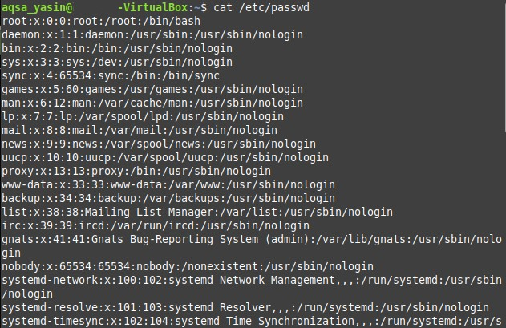

Slide 5
Method # 2: The “awk” command
The “awk” command is helpful if you want to display usernames only, which may be useful if you do not need all the technical details returned with the “cat” command. To use this command to list all users in a Linux system, the following steps should be performed in order:
Launch the terminal.
Run the following command:
$ awk –F: ‘{ print $1}’ /etc/passwd
Notes:
Aho, Weinberger, and Kernighan.

Slide 6
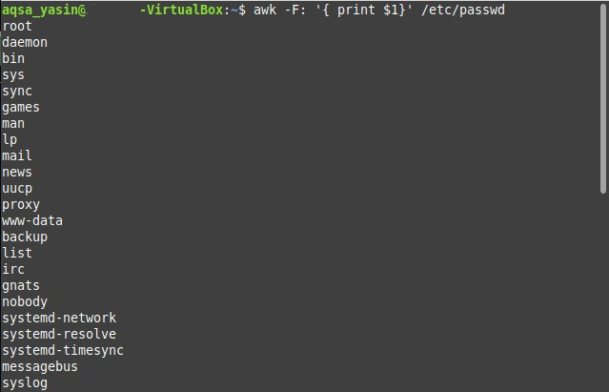

Slide 7
Method # 3: The “compgen” command
Like the “awk” command, this command is used to display only usernames, ignoring all other details. To use the “compgen” command to list all users of the Linux system, the following steps should be performed in order:
Launch the terminal.
Run the following command:
compgen –u
Notes:
compgen is a bash built-in command which is used to list all the commands that could be executed in the Linux system. This command could also be used to count the total number of commands present in the terminal or even to look for a command with the specific keyword

Slide 8
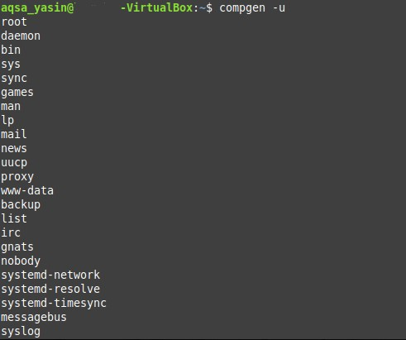

Slide 9
Method # 4: The “getent” command
The output of the “getent” command is very similar to that of the “cat” command, as it displays a lot of details along with the usernames. To use the “getent” command to list all users in the Linux system, the following steps should be performed in order:
Launch the terminal.
Run the following command:
$ getent passwd
Notes:
(get entries from the administrative database)

Slide 10
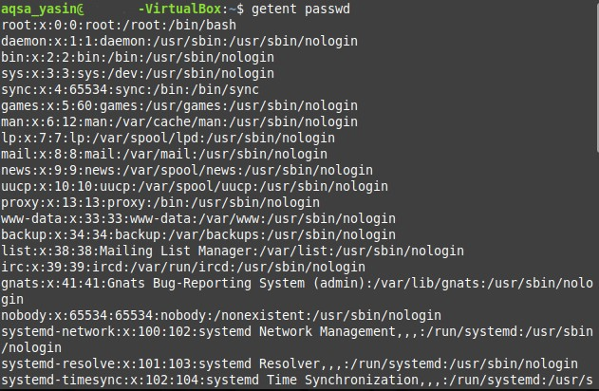

Slide 11
Basic syntax of command is:
$ useradd [options] username

Slide 12
How to Add a New User in Linux
To add/create a new user, all you’ve to follow the command ‘useradd‘ or ‘adduser‘ with ‘username’. The ‘username’ is a user login name, that is used by user to login into the system.
Only one user can be added and that username must be unique (different from other username already exists on the system).
For example, to add a new user called ‘tecmint‘, use the following command.
[root@tecmint ~]# useradd tecmint
When we add a new user in Linux with ‘useradd‘ command it gets created in locked state and to unlock that user account, we need to set a password for that account with ‘passwd‘ command.
root@tecmint ~]# passwd tecmint
Changing password for user tecmint.
New UNIX password:
Retype new UNIX password:
passwd: all authentication tokens updated successfully.

Slide 13
Once a new user created, it’s entry automatically added to the ‘/etc/passwd‘ file. The file is used to store users information and the entry should be.
tecmint:x:504:504:tecmint:/home/tecmint:/bin/bash
The above entry contains a set of seven colon-separated fields, each field has it’s own meaning. Let’s see what are these fields:
Username: User login name used to login into system. It should be between 1 to 32 charcters long.
Password: User password (or x character) stored in /etc/shadow file in encrypted format.
User ID (UID): Every user must have a User ID (UID) User Identification Number. By default UID 0 is reserved for root user and UID’s ranging from 1-99 are reserved for other predefined accounts. Further UID’s ranging from 100-999 are reserved for system accounts and groups.
Group ID (GID): The primary Group ID (GID) Group Identification Number stored in /etc/group file.
User Info: This field is optional and allow you to define extra information about the user. For example, user full name. This field is filled by ‘finger’ command.
Home Directory: The absolute location of user’s home directory.
Shell: The absolute location of a user’s shell i.e. /bin/bash.

Slide 14
Grep Command in Linux
Grep command is the most powerful and regularly used Linux command-line utility. Using Grep, you can search for useful information by specifying a search criteria. It searches for a particular expression pattern in a specified file. When it finds a match, it prints all the lines of a file that matched the specified pattern. It comes in handy when you have to filter through large log files.
Notes:
(global regular expression print)

Slide 15
Create a User with Different Home Directory
By default ‘useradd‘ command creates a user’s home directory under /home directory with username. Thus, for example, we’ve seen above the default home directory for the user ‘tecmint‘ is ‘/home/tecmint‘.
However, this action can be changed by using ‘-d‘ option along with the location of new home directory (i.e./data/projects). For example, the following command will create a user ‘anusha‘ with a home directory ‘/data/projects‘.
[root@tecmint ~]# useradd -d /data/projects anusha
You can see the user home directory and other user related information like user id, group id, shell and comments.
[root@tecmint ~]# cat /etc/passwd | grep anusha
anusha:x:505:505::/data/projects:/bin/bash

Slide 16

Using Grep
Here is the basic syntax of grep command. It starts with grep followed by some options and search criteria and then ends with the file name.
$ grep [options] PATTERN [FILE...]
Search for files
To search for a file name in a directory that contains a specific string in it, you can use grep in the following way:
$ ls -l | grep -i “string
For instance, to search for a filename that contains a string “test“, the command would be:
$ ls –l | grep –i test
This command lists all the files that contain the string “test.

Slide 17
Create a User with Specific User ID
In Linux, every user has its own UID (Unique Identification Number). By default, whenever we create a new user accounts in Linux, it assigns userid 500, 501, 502 and so on…
But, we can create user’s with custom userid with ‘-u‘ option. For example, the following command will create a user ‘navin‘ with custom userid ‘999‘.
[root@tecmint ~]# useradd -u 999 navin
Now, let’s verify that the user created with a defined userid (999) using following command.
[root@tecmint ~]# cat /etc/passwd | grep navin
navin:x:999:999::/home/navin:/bin/bash
NOTE: Make sure the value of a user ID must be unique from any other already created users on the system.

Slide 18
Add a User without Home Directory
In some situations, where we don’t want to assign a home directories for a user’s, due to some security reasons. In such situation, when a user logs into a system that has just restarted, its home directory will be root. When such user uses su command, its login directory will be the previous user home directory.
To create user’s without their home directories, ‘-M‘ is used. For example, the following command will create a user ‘shilpi‘ without a home directory.
[root@tecmint ~]# useradd -M shilpi
Now, let’s verify that the user is created without home directory, using ls command.
[root@tecmint ~]# ls -l /home/shilpi
ls: cannot access /home/shilpi: No such file or directory

Slide 19
Create a User with Password Expiry Date
The ‘-f‘ argument is used to define the number of days after a password expires. A value of 0 inactive the user account as soon as the password has expired. By default, the password expiry value set to -1 means never expire.
Here in this example, we will set a account password expiry date i.e. 45 days on a user ‘tecmint’ using ‘-e‘ and ‘-f‘ options.
[root@tecmint ~]# useradd -e 2014-04-27 -f 45 tecmint

Slide 20
Add a User with Custom Comments
The ‘-c‘ option allows you to add custom comments, such as user’s full name, phone number, etc to/etc/passwd file. The comment can be added as a single line without any spaces.
For example, the following command will add a user ‘mansi‘ and would insert that user’s full name, Manis Khurana, into the comment field.
[root@tecmint ~]# useradd -c "Manis Khurana" mansi
You can see your comments in ‘/etc/passwd‘ file in comments section.
[root@tecmint ~]# tail -1 /etc/passwd
mansi:x:1006:1008:Manis Khurana:/home/mansi:/bin/sh

Slide 21
Change User Login Shell:
Sometimes, we add users which has nothing to do with login shell or sometimes we require to assign different shells to our users. We can assign different login shells to a each user with ‘-s‘ option.
Here in this example, will add a user ‘tecmint‘ without login shell i.e. ‘/sbin/nologin‘ shell.
[root@tecmint ~]# useradd -s /sbin/nologin tecmint
You can check assigned shell to the user in ‘/etc/passwd‘ file.
[root@tecmint ~]# tail -1 /etc/passwd
tecmint:x:1002:1002::/home/tecmint:/sbin/nologin

Slide 22
Add a User with Specific Home Directory, Default Shell and Custom Comment
The following command will create a user ‘ravi‘ with home directory ‘/var/www/tecmint‘, default shell /bin/bashand adds extra information about user.
[root@tecmint ~]# useradd -m -d /var/www/ravi -s /bin/bash -c "TecMint Owner" -U ravi
In the above command ‘-m -d‘ option creates a user with specified home directory and the ‘-s‘ option set the user’s default shell i.e. /bin/bash. The ‘-c‘ option adds the extra information about user and ‘-U‘ argument create/adds a group with the same name as the user.

Slide 23
Add a User with Home Directory, Custom Shell, Custom Comment and UID/GID
The command is very similar to above, but here we defining shell as ‘/bin/zsh‘ and custom UID and GID to a user ‘tarunika‘. Where ‘-u‘ defines new user’s UID (i.e. 1000) and whereas ‘-g‘ defines GID (i.e. 1000).
[root@tecmint ~]# useradd -m -d /var/www/tarunika -s /bin/zsh -c "TecMint Technical Writer" -u 1000 -g 1000 tarunika

Slide 24
Add a User with Home Directory, No Shell, Custom Comment and User ID
The following command is very much similar to above two commands, the only difference is here, that we disabling login shell to a user called ‘avishek‘ with custom User ID (i.e. 1019).
Here ‘-s‘ option adds the default shell /bin/bash, but in this case we set login to ‘/usr/sbin/nologin‘. That means user ‘avishek‘ will not able to login into the system.
[root@tecmint ~]# useradd -m -d /var/www/avishek -s /usr/sbin/nologin -c "TecMint Sr. Technical Writer" -u 1019 avishek

Slide 25
Add a User with Home Directory, Shell, Custom Skell/Comment and User ID
The only change in this command is, we used ‘-k‘ option to set custom skeleton directory i.e. /etc/custom.skell, not the default one /etc/skel. We also used ‘-s‘ option to define different shell i.e. /bin/tcsh to user ‘navin‘.
[root@tecmint ~]# useradd -m -d /var/www/navin -k /etc/custom.skell -s /bin/tcsh -c "No Active Member of TecMint" -u 1027 navin

Slide 26
Add a User with Home Directory, No Shell, Custom Comment and User ID
The following command is very much similar to above two commands, the only difference is here, that we disabling login shell to a user called ‘avishek‘ with custom User ID (i.e. 1019).
Here ‘-s‘ option adds the default shell /bin/bash, but in this case we set login to ‘/usr/sbin/nologin‘. That means user ‘avishek‘ will not able to login into the system.
[root@tecmint ~]# useradd -m -d /var/www/avishek -s /usr/sbin/nologin -c "TecMint Sr. Technical Writer" -u 1019 avishek

Slide 27
Add a User with Home Directory, Shell, Custom Skell/Comment and User ID
The only change in this command is, we used ‘-k‘ option to set custom skeleton directory i.e. /etc/custom.skell, not the default one /etc/skel. We also used ‘-s‘ option to define different shell i.e. /bin/tcsh to user ‘navin‘.
[root@tecmint ~]# useradd -m -d /var/www/navin -k /etc/custom.skell -s /bin/tcsh -c "No Active Member of TecMint" -u 1027 navin

Slide 28
Add a User without Home Directory, No Shell, No Group and Custom Comment
This following command is very different than the other commands explained above. Here we used ‘-M‘ option to create user without user’s home directory and ‘-N‘ argument is used that tells the system to only create username (without group). The ‘-r‘ arguments is for creating a system user.
[root@tecmint ~]# useradd -M -N -r -s /bin/false -c "Disabled TecMint Member" clayton

